Slide 1
CPU Intro
CS 0447
Jarrett Billingsley

Slide 2
Class announcements
I will try very hard to get the exams graded by the end of next week, so that you will know where you stand in the class before the withdrawal period ends

Slide 3
ISA and hardware design

Slide 4
Remember what an ISA is?
it's the software interface the programmer uses to control the CPU
what are some important aspects of the MIPS ISA?
what instructions does it have?
how many registers does it have?
how many operands do they have?
how big are they?
are there any special registers?
how are they encoded into binary?
how does it access memory?
the ISA abstracts the hardware design
but the hardware must implement the ISA, so…
Notes:
- Instruction Set Architecture
- it has 32 32-bit registers, plus 3 more…
- $zero is always 0, and ra is used by jal, but otherwise they're identical
- HI and LO are 32 bits and are used by the multiplication and division instructions
- the PC is 32 bits and is its own thing
- it has lots of instructions: arithmetic, conditional branches, loads and stores, jumps…
- instructions can have 0-3 operands, of which 1 or 2 can be sources, and 0 or 1 can be destinations
- there are actually 3 instruction formats: R, I, and J
- only loads and stores access memory
- it can access 8, 16, or 32-bit values from memory
- the memory address that is accessed is a register + an immediate offset

Slide 5
Tension you can cut with a knife
designing an ISA is an act of balancing many, many factors.
the users have demands…
…and the implementers have limits.
more registers!
propagation delay!
more bits!
more powerful instructions!
materials cost!
power and heat!
run this popular language fast!
manufacturing ability!
verifiability!
make the OS faster!
Notes:
- verifiability means "mathematically proving that your design is right and has no bugs," which is often left in the dust in favor of constantly churning out new features and performance improvements
- which is how we've gotten where we are now, with hundreds of bugs and dozens of vulnerabilities in our CPUs
- yes, hardware can absolutely have bugs too. doesn’t that make you feel all warm and fuzzy?

Slide 6
Meeting in the middle
first we broke software into small pieces
now we'll build hardware from small pieces
Control Structures
ASM Instructions
Machine Code
the ISA specifies the software interface to the CPU…
????????????????
but what does the CPU look like? what parts does it have? how does it understand the instructions?
MUXes, FSMs, etc.
Gates and Latches
Transistors
Physics and Electricity
where does the magic happen?
Notes:
- in most complex systems, the "magic" comes from the ways things are interconnected, rather than from the pieces themselves
- this is what the overused phrase "more than the sum of its parts" means

Slide 7
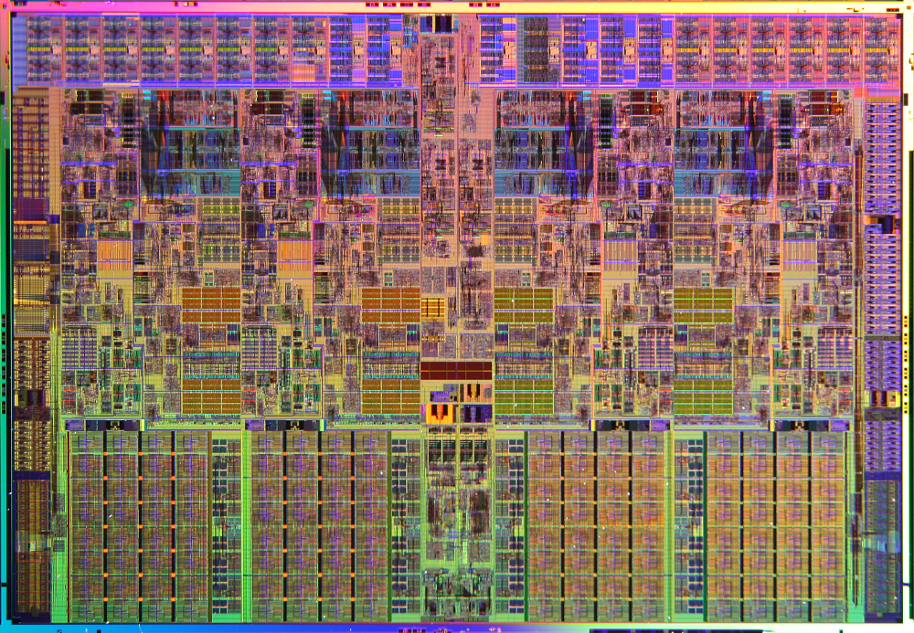
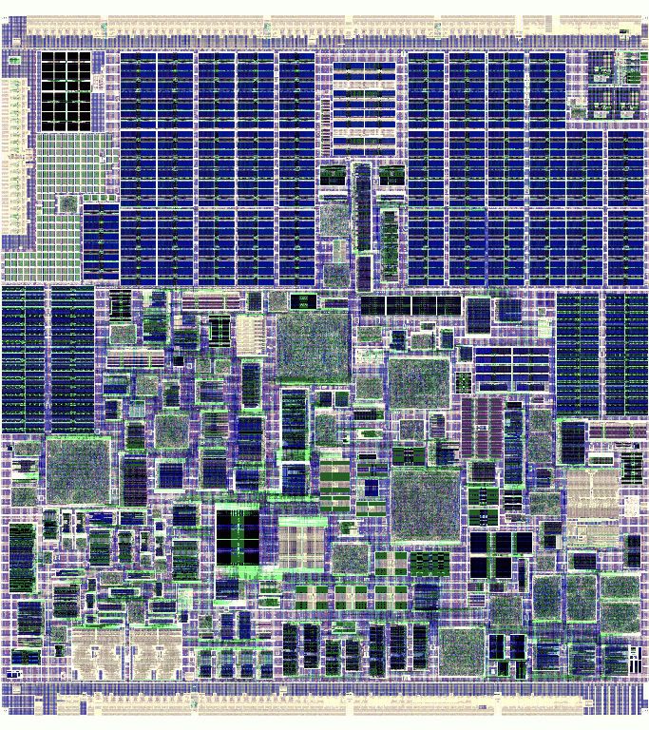
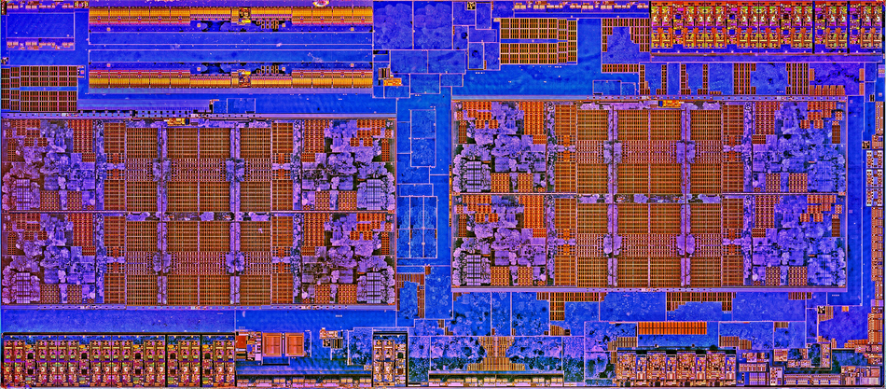
Microarchitecture
microarchitecture is the hardware design of a physical CPU.
a microarchitecture is an implementation of an ISA.
and like interfaces in Java, there can be many implementations of the same ISA.
interface X86_64
class Core_i7 implements X86_64
class Zen implements X86_64
class Nano implements X86_64
but there is a lot of freedom in how the CPU actually implements that interface.
Notes:
- we may have been using x64 for almost 20 years, but the CPUs today are drastically different in design than the original x64 designs.
- abstraction gives us a lot of freedom to change things!

Slide 8
Only kinda sorta MIPS
we'll use MIPS for context…
but this stuff applies to virtually any architecture.
such as the architecture you'll implement for the last project!!
the book doesn't use "real" MIPS either
it uses DLX: a simplified, modernized version of MIPS
the hardware in the book is extremely hand-wave-y (what's jal?)
but they go into way more detail than needed for some things…
Notes:
- the section on the ALU is, like, woah guys, we get it. you designed a CPU.

Slide 9
CPU Organization

Slide 10
Remember this?
unresolved questions:
what's the control?
what's the ALU?
how does it know what instruction to get next?
how does it know which registers to access?
how does it know whether it should add, subtract, etc.?
Memory
Program
Control
Registers
instruction
3
5
8
A
B
C
ALU
+
Processor

Slide 11
Zooming in
there are a few major parts of any CPU:
Control
the control tells everything else what to do, and when
if(add)
do this
else if...
hi i'm memory!!
÷
Registers
ALU
t0
fp
+
×
s4
-
at
control signals!
⊕
∫
☃
sp
&
eax?
values move between them
registers hold the values being computed
the ALU computes new values
Notes:
- what, you've never seen the snowman operator?

Slide 12
OKAY, MEMORY, WHAT DO YOU WANT??
registers are just a temporary stopping point for your program's data
you could have a computer with few/no registers at all!
Memory
this is a memory-memory machine
Control
if you squint and wave your hands really hard, every computer is.
ALU
the registers and the memory only differ in their speed and size.
Notes:
- really, we only have registers because our memory technologies are imperfect and we have to play to the strengths of each.
- if we suddenly had a breakthrough in memory technology, we could unify the registers, memory, and persistent storage and be done with it.

Slide 13
Parts of the CPU

Slide 14
Architectural and general-purpose registers
the registers that the ISA specifies are the architectural registers
and of those, the general-purpose registers (GPRs) are the ones that you can use for any purpose in your programs
Microarchitectural
Architectural
microarchitectural registers exist outside the ISA and are instead part of the implementation of the CPU.
GPRs
tx
vx
pc
ax
sx
zero
sp
hi
kx
they're used for temporary storage, to implement multi-step operations, to control special features, etc.
fp
lo
they are often (but not always!) inaccessible from software.
Notes:
- many CPUs have debugging registers that are not accessible by normal means, but can be accessed through "secret" means like JTAG (a way of debugging hardware)
- there are often "temporary" registers the CPU uses to implement multi-step (complex) instructions

Slide 15
The register file
the register file holds the general-purpose registers.
it's like an array of registers, or a small word-addressed memory.
notice how the MIPS registers are numbered?
D
Q
$0
en
D
Q
$1
en
register number go in…
register value come out.
D
Q
$2
maybe two at a time.
en
that might be useful.
and we should also be able to put values into them, too.
D
Q
$3
en
D
Q
$4
en
don't worry, we'll see how it works. but that's really all it is.
D
Q
$5
en
etc…
Notes:
- dunno why it's called a file... it's likely historical.
- actually we don't need a register for $0, since it's just….. zero……………….

Slide 16
The Arithmetic and Logic Unit (ALU)
the ALU takes old values and produces new values from them.
ALU
in all the arithmetic and logic (bitwise) instructions, how many input operands are there?
A
+
-
×*
÷*
what kind of operations do we have to be able to do?
&
|
~
<<
B
>>
>>>
*multiplication and division are kinda weirdos…
Notes:
- 2. allllways 2.
- we might consider putting mult/div in their own unit, separate from the ALU, but right next to it.
- cause they're slower.
- we'll talk about this okay

Slide 17
The program counter and control
the PC register is part of the control: it says what step to do next.
the PC is a memory address, so we send that to memory.
Memory
Control
PC
0xAC30
0xC0DE
the memory sends back some data: an instruction.
this is an add instruction!
the source regs are t0 and t8…
the control decodes the instruction and tells everything else what to do.
Notes:
- ooh, maybe that instruction goes into a microarchitectural register!

Slide 18
The bottomless pit of control
the registers and ALU are actually pretty simple.
control is where things get… interesting.
we'll be studying the simplest kinds of control
but there's no real upper limit on the complexity of control.
in a sense, CPU design is control design. the other parts are largely interchangeable.
Notes:
- and when I say interchangeable, I mean it – it's common for CPU designers to reuse parts of CPUs in many designs, even in implementations of different ISAs!
- e.g. AMD made a RISC ISA, the 29k, which didn't last for long…
- but their K5 (Pentium equivalent) was a 29k with an x86 instruction decoder bolted on the front and it worked pretty damn well
- funny cause that's basically how all x86 CPUs are now designed

Slide 19
What the CPU does
all the parts of the CPU work together to do the CPU’s job: to read and execute instructions. it does this for every instruction:
it fetches the next instruction to execute from memory;
Memory
Program
then the control decodes (reads) the instruction;
read registers t2 and t4! add their contents! put the result in register a0!
then the control executes the instruction by telling the other parts what to do.
Control
Registers
instruction
👀
ALU
fetch, decode, execute. once per instruction.
Processor

Slide 20
If every instruction has to be fetched from memory…
…then how many times is memory accessed for a load or store?
for a load, we do one access to fetch the instruction…
Memory
lw t0, var
…and a second access to actually load the value!
...
Control
Registers
a store would store the value on the second access.
123
ALU
var
this is going to have Implications™️ for how we implement loads and stores later…

Slide 21
A small taste of design this is really just for context don't worry about remembering this okay

Slide 22
Tug-of-war
register file design is constrained by many competing factors.
compilers love lots of identical registers!
ISA says instructions have 2 operands and 1 destination
…but there are diminishing returns.
fast L1 cache? not as many regs needed
…except for this one instruction that has 2 destinations.
multi-issue CPU: need to read 4 regs and write 2
humans like intuitive assembly language!
more registers means more silicon…
with lots of registers, function calls are faster!
…but context switches are slower.

Slide 23
It doesn't have to be this way
CISC CPUs usually have small sets of registers, and many have special purposes or behaviors
RISC CPUs usually have 32* mostly-interchangeable registers: MIPS, RISC, SPARC, ARMv8, AVR, RISC-V…
8086
ax
bx
cx
dx
si
di
sp
bp
z80
a | f
b | c
d | e
h | l
ix
iy
sp
6502
A
X
Y
PDP8
AC
r0 | r1 | r2 | r3 | r4 | r5 | r6 | r7
r8 | r9 | r10 | r11 | r12 | r13 | r14 | r15
r16 | r17 | r18 | r19 | r20 | r21 | r22 | r23
r24 | r25 | r26 | r27 | r28 | r29 | r30 | r31
32/64 bits
12 bits
8 bits
why?
16 bits
*or 32 at a time
Notes:
- RISC is made for compilers to write programs; CISC is made for humans to write programs.
- humans are weird, can only keep a few things in their brains at once, and need help with names and stuff.
- compilers want lots of identical registers because then it's much easier to produce machine code algorithmically.

Slide 24
Because it’s a good number
there are often many solutions to a given problem.
engineering is about picking the “most appropriate” solution given the constraints.
the constraints on register files have shifted over time…
and a lot of people have spent a lot of time researching The Best Way to build a register file based on those constraints.
don’t reinvent the wheel unless you know why it’s round.
sometimes people keep doing things out of momentum – “cause that’s how we’ve always done it!” – but other times there are good reasons, and it’s important to be able to tell which is which!

Slide 25
A word of advice
you will see many imperfect designs in your life…
but in problem-solving, perfection isn't always the goal.
everyone has to work within the constraints they're given.
sometimes the goal is to solve something quickly, or cheaply, or simply, or understandably, or compatibly, or…
don't be a judgmental ass about someone else's design because one, it's shitty, and two, they know more about why it was designed that way, so you're just being presumptuous. just ASK THEM.
9 times out of 10 it's because their boss told them to
the profit motive messes with a lot of things.

